Slide 1
MDA Lecture 9 Similarity clustering

Slide 2
Similarity clustering
Similarity data
Similarity clusters inherited from k-means
  One-cluster clustering
  Agglomeration; stopping criterion
Summary criteria
  Uniform threshold
  Modularity transformation
Normalized cut, Laplace transformation, and spectral clustering

Slide 3
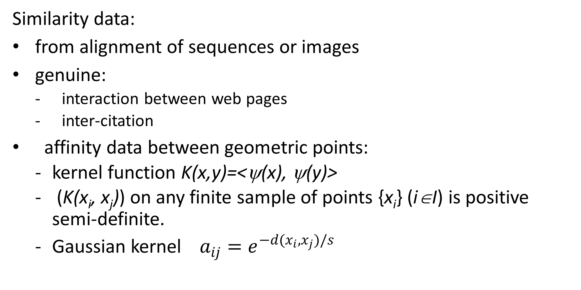
Similarity clustering
Similarity data:
from alignment of sequences or images
genuine:
  interaction between web pages
  inter-citation
affinity data between geometric points:
  kernel function K(x,y)=<ψ(x), ψ(y)>
  (K(x_{i}, x_{j})) on any finite sample of points {x_{i}} (i∈I) is positive semi-definite.
  Gaussian kernel$a_{ij}=e^{−d(x_{i},x_{j})/s}$

Slide 4
Criterion inherited from k-means

Slide 5
Recall Pythagorean decomposition
K-Means criterion:
T = F(S,c) + D(S,c)
Data_Scatter = “Explained Part” + ”Unexplained Part”

Slide 6
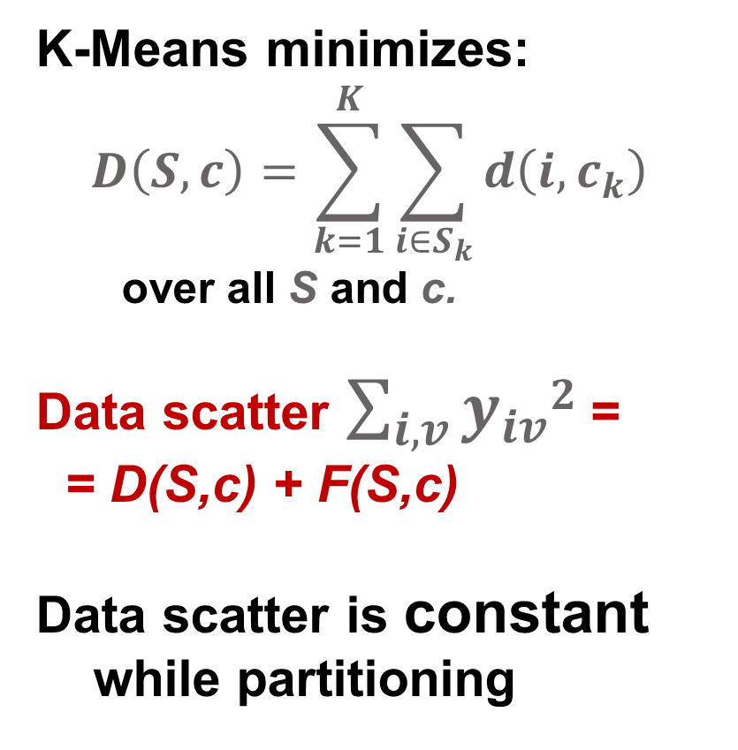
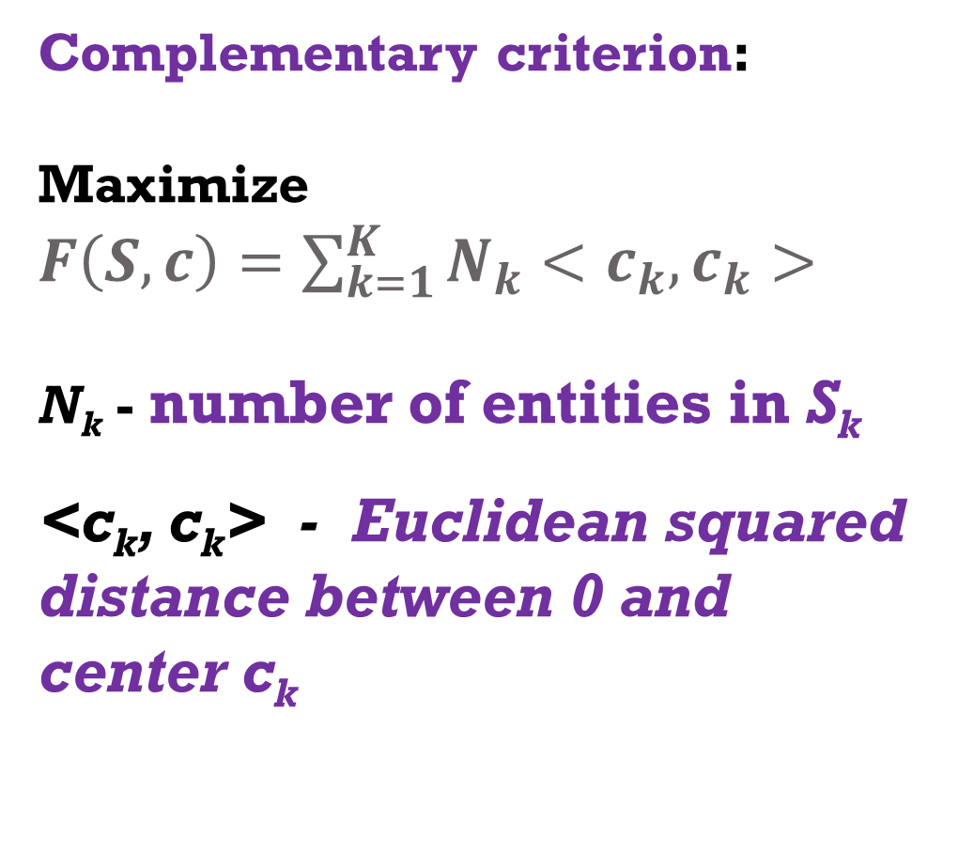
Complementary clustering criterion
K-Means minimizes:
$$D\left(S,c\right)=\sum_{k=1}^{K}{\sum_{i∈S_{k}}{d\left(i,c_{k}\right)}}$$
over all S and c.
Data scatter $\sum_{i,v}{y_{iv}2}$ =
= D(S,c) + F(S,c)
Data scatter is constant
while partitioning
Complementary criterion:
Maximize
$F\left(S,c\right)=\sum_{k=1}^{K}{N_{k}<c_{k},c_{k}>}$
N_{k} - number of entities in S_{k}
<c_{k}, c_{k}> - Euclidean squared distance between 0 and center c_{k}

Slide 7
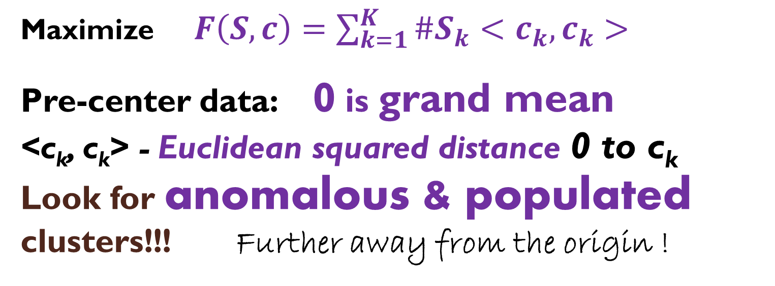
K-Means complementary criterion
Maximize $F\left(S,c\right)=\sum_{k=1}^{K}{{\#S}_{k}<c_{k},c_{k}>}$
Pre-center data: 0 is grand mean
<c_{k}, c_{k}> - Euclidean squared distance 0 to c_{k} Look for anomalous & populated clusters!!! Further away from the origin !

Slide 8
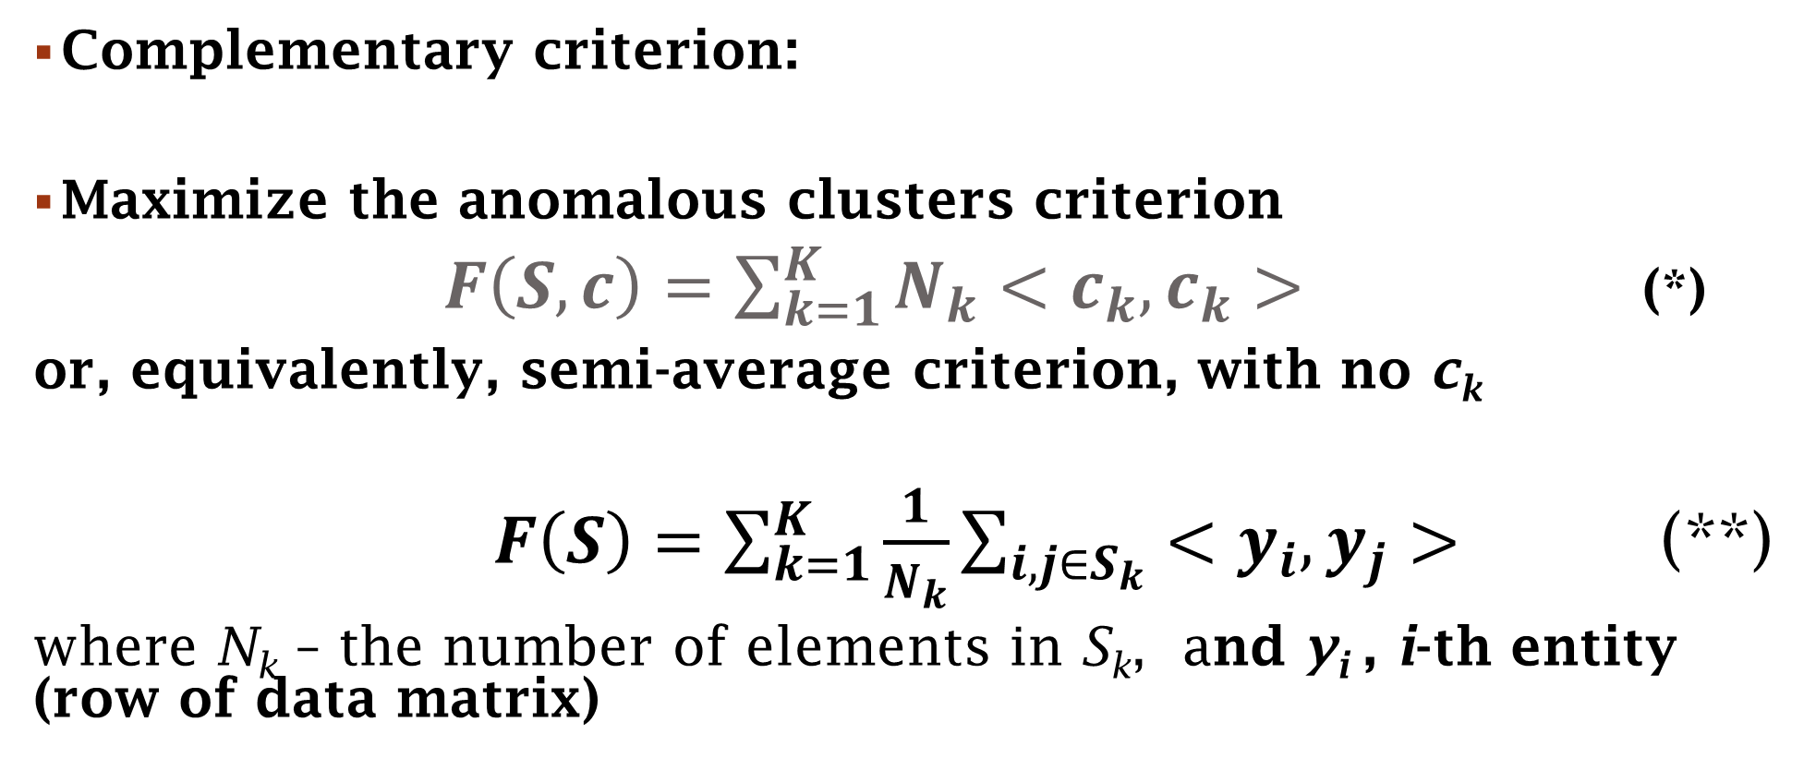
Criterion inherited from k-means, 1
Complementary criterion:
Maximize the anomalous clusters criterion
$F\left(S,c\right)=\sum_{k=1}^{K}{N_{k}<c_{k},c_{k}>}$ (*)
or, equivalently, semi-average criterion, with no c_{k}
$F\left(S\right)=\sum_{k=1}^{K}{\frac{1}{N_{k}}}\sum_{i,j∈S_{k}}{<y_{i},y_{j}>}$ (**)
where N_{k} – the number of elements in S_{k}, and y_{i} , i-th entity (row of data matrix)

Slide 9
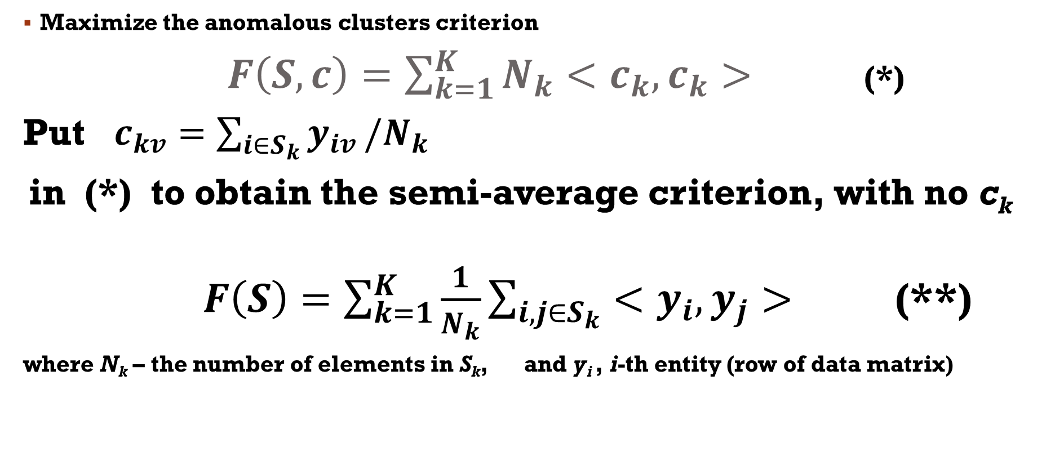
Criterion inherited from k-means, 2
Maximize the anomalous clusters criterion
$F\left(S,c\right)=\sum_{k=1}^{K}{N_{k}<c_{k},c_{k}>}$ (*)
Put $c_{kv}=\sum_{i∈S_{k}}{y_{iv}}/N_{k}$
in (*) to obtain the semi-average criterion, with no c_{k}
$F\left(S\right)=\sum_{k=1}^{K}{\frac{1}{N_{k}}}\sum_{i,j∈S_{k}}{<y_{i},y_{j}>}$ (**)
where N_{k} – the number of elements in S_{k}, and y_{i} , i-th entity (row of data matrix)

Slide 10
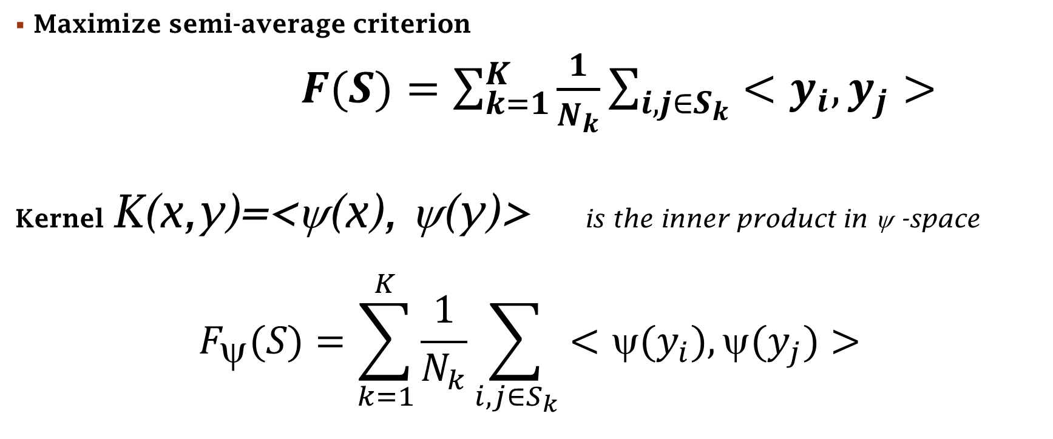
Criterion inherited from k-means, 3:
Kernel trick
Maximize semi-average criterion
$F(S)=\sum_{k=1}^{K}{\frac{1}{N_{k}}}\sum_{i,j∈S_{k}}{<y_{i},y_{j}>}$
Kernel K(x,y)=<ψ(x), ψ(y)> is the inner product in ψ -space
$$F_{ψ}(S)=\sum_{k=1}^{K}{\frac{1}{N_{k}}}\sum_{i,j∈S_{k}}{<{ψ(y}_{i}),{ψ(y}_{j})>}$$

Slide 11
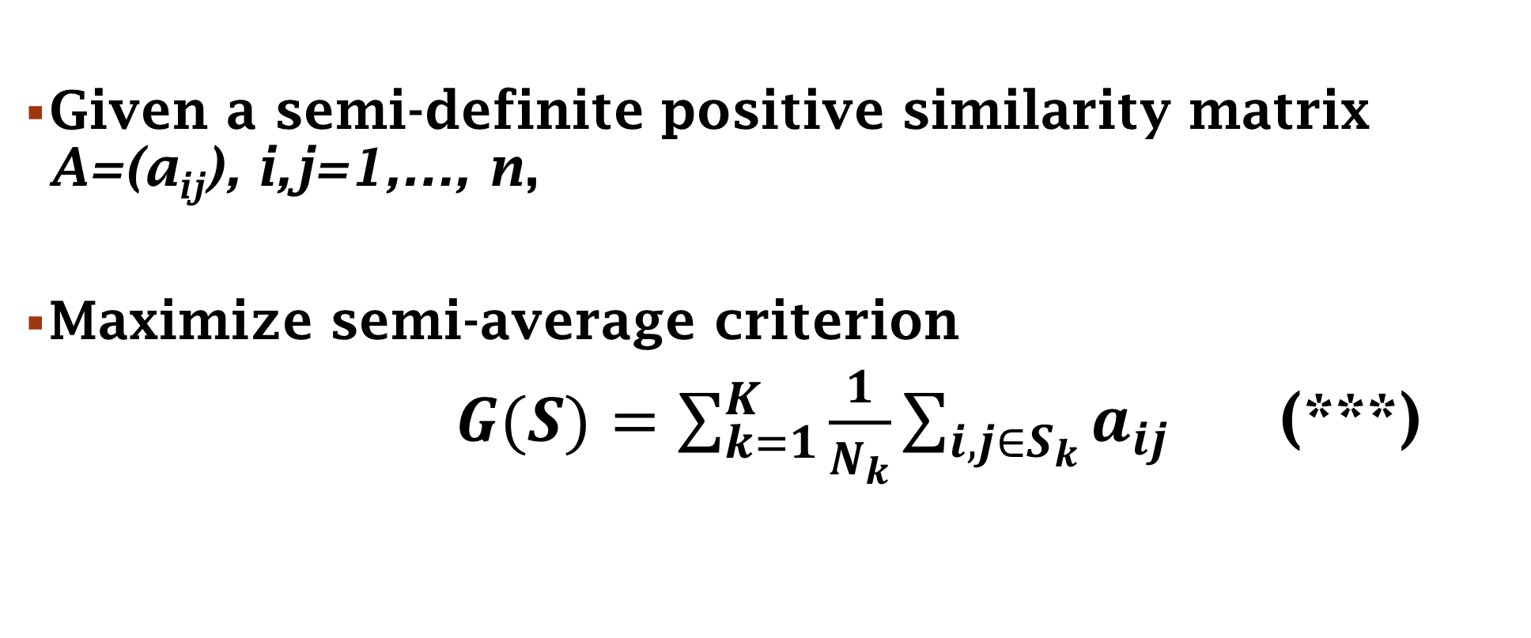
Criterion inherited from k-means, 4:
Kernel trick
Given a semi-definite positive similarity matrix A=(a_{ij}), i,j=1,…, n,
Maximize semi-average criterion
$G(S)=\sum_{k=1}^{K}{\frac{1}{N_{k}}}\sum_{i,j∈S_{k}}{a_{ij}}$ (***)

Slide 12
Two approaches to locally maximize G(S), out of many
One cluster by one
Agglomeration

Slide 13
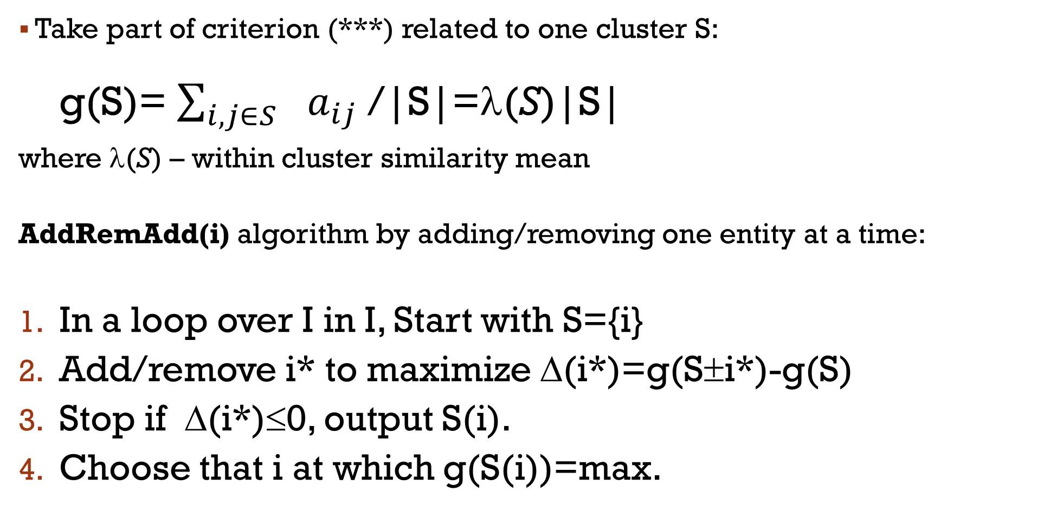
One Cluster by one, 2-greedy way
Take part of criterion (***) related to one cluster S:
  g(S)= $\sum_{i,j∈S_{}}{a_{ij}}$/|S|=λ(S)|S|
where λ(S) – within cluster similarity mean
AddRemAdd(i) algorithm by adding/removing one entity at a time:
In a loop over I in I, Start with S={i}
Add/remove i* to maximize Δ(i*)=g(S±i*)-g(S)
Stop if Δ(i*)≤0, output S(i).
Choose that i at which g(S(i))=max.

Slide 14
One Cluster with semi-average criterion
Semi-average criterion:
  max g(S)= λ(S)|S|
where λ(S) – within cluster mean with AddRemAdd(i) properties:
Spectral: max
Rayleigh quotient
Tight: the average similarity between S and j
> λ(S) /2 if j∈S
< λ(S) /2 if j∉S

Slide 15
Semi-average criterion: extensions to entire data set
Partitional: Take set of all entities I
  1. Compute S(i)=AddRem(i) for all i∈I;
  2. Take S=S(i*) for i* maximizing f(S(i)) over all I
  3. Remove S from I; if I is not empty, goto 1; else halt.
Additive: Take set of all entities I
  1. Compute S(i)=AddRem(i) for all i∈I;
  2. Take S=S(i*) for i* maximizing f(S(i)) over all I
  3. subtract a(S)ss^{T} from A; if No-stop-condition, goto 1; else halt.
Explorative: Take set of all entities I
  1. Compute S(i)=AddRem(i) for all i∈I;
  2. Leave those S(i) that do not much overlap.

Slide 16
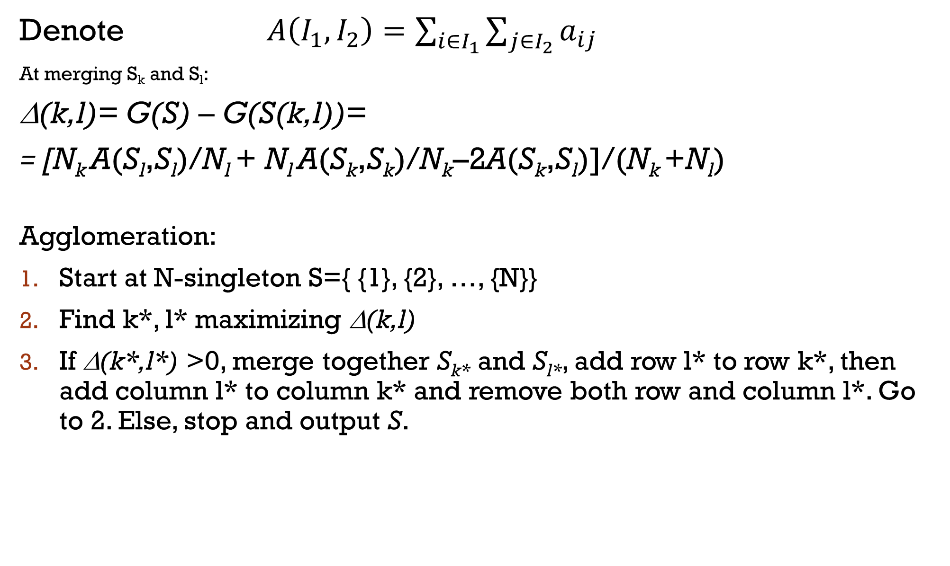
Agglomeration to maximize semi-average G(S)
Denote $A\left(I_{1},I_{2}\right)=\sum_{i∈I_{1}}{\sum_{j∈I_{2}}{a_{ij}}}$
At merging S_{k} and S_{l}:
Δ(k,l)= G(S) – G(S(k,l))=
= [N_{k} A(S_{l},S_{l})/N_{l} + N_{l} A(S_{k},S_{k})/N_{k}–2A(S_{k},S_{l})]/(N_{k} +N_{l})
Agglomeration:
Start at N-singleton S={ {1}, {2}, …, {N}}
Find k*, l* maximizing Δ(k,l)
If Δ(k*,l*) >0, merge together S_{k*} and S_{l*}, add row l* to row k*, then add column l* to column k* and remove both row and column l*. Go to 2. Else, stop and output S.

Slide 17
Example: Digits 0, 1, 2,…, 9 confusion data (symmetrized)
Stimulus | Response 1 2 3 4 5 6 7 8 9 0
1 2 3 4 5 6 7 8 9 0 | 877 11 18 86 9 20 165 6 15 11 11 782 38 13 31 31 9 29 18 11 18 38 681 6 31 4 31 29 132 11 86 13 6 732 9 11 26 13 44 6 9 31 31 9 669 88 7 13 104 11 20 31 4 11 88 633 2 113 11 31 165 9 31 26 7 2 667 6 13 16 6 29 29 13 13 113 6 577 75 122 15 18 132 44 104 11 13 75 550 32 11 11 11 6 11 31 16 122 32 818

Slide 18
Agglomerative tree for confusion between digits
1 7 4 3 9 5 6 8 2 0

Slide 19
At consecutive mergers
Δ(k,l): -484.0, -492.5, -605.3, -607.5, -667.6, -726.2, -746.4, -767.3
Why decrease changes steadily from merger to merger? I do not know. Perhaps, to manifest the existence of a natural clustering…

Slide 20
Semi-average clustering results at between-digit confusion with zeroed diagonal
180
120
60
0
1 7 4 5 6 2 8 0 3 9

Slide 21
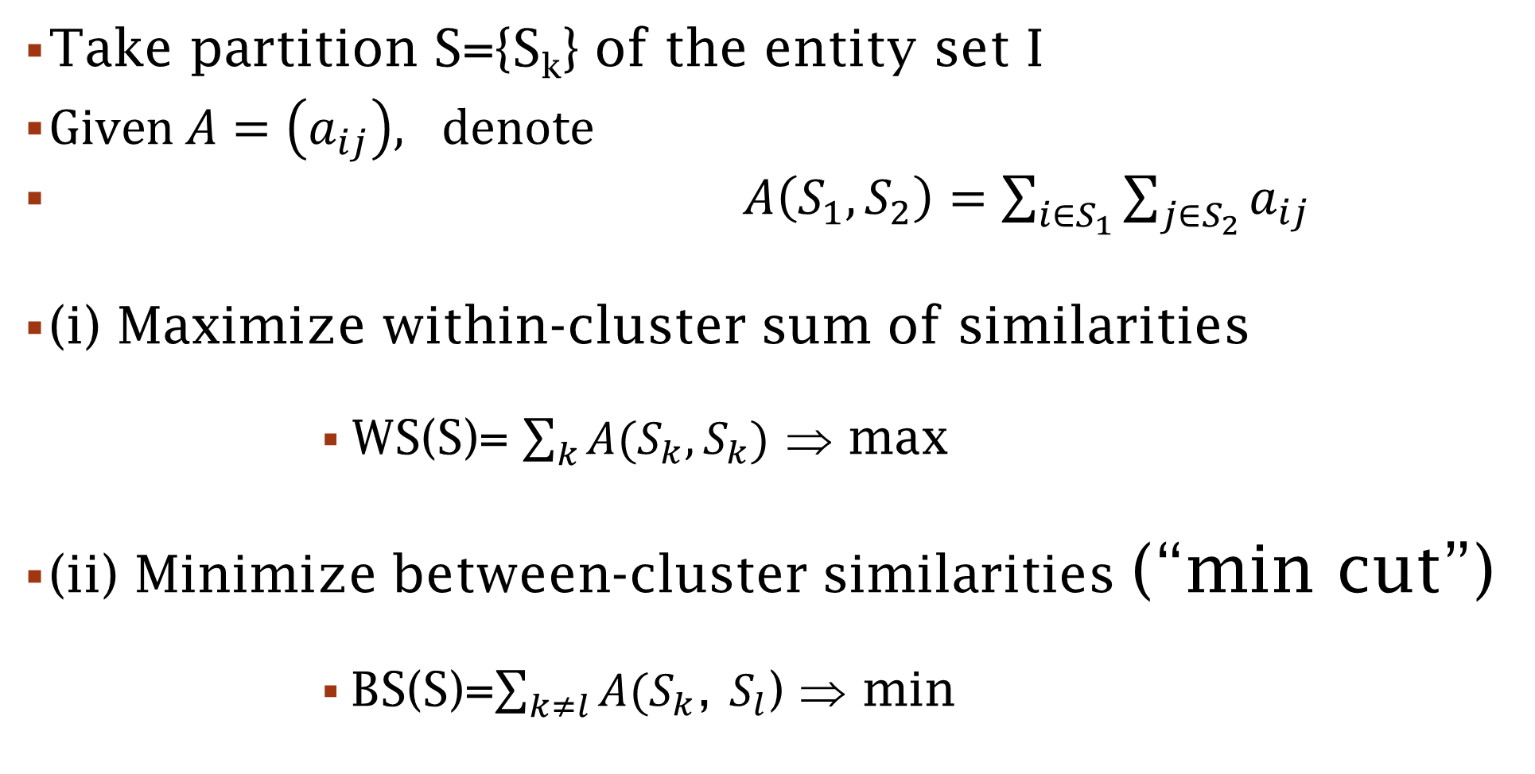
Summary clustering, 1
Take partition S={S_{k}} of the entity set I
$Given A=\left(a_{ij}\right), denote$
$A\left(S_{1},S_{2}\right)=\sum_{i∈S_{1}}{\sum_{j∈S_{2}}{a_{ij}}}$
(i) Maximize within-cluster sum of similarities
                WS(S)= $\sum_{k}{A(S_{k},S_{k})}$ ⇒ max
(ii) Minimize between-cluster similarities (“min cut”)
                BS(S)=$\sum_{k≠l}{A(S_{k}}$, $S_{l}$) ⇒ min

Slide 22
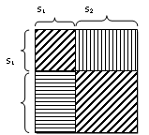
Summary clustering, 2
Within-cluster sum of similarities ⇒ max
Between-cluster sum of similarities ⇒ min
These two are equivalent:
WS diagonally stripped,
BS horizontally stripped,
Equal to the sum of all the
entries in total

Slide 23
Summary clustering, 3
Within-cluster sum of similarities ⇒ max
Between-cluster sum of similarities ⇒ min (min cut)
If similarities are non-negative, trivially solved: put all high similarity values into one big cluster, leaving others singletons
Addressing: subtract “background” - to zero the total of entries
  Uniform shift
  Modularity transformation

Slide 24
Summary clustering with Subtracted background: uniform shift
At optimal S,
A(S_{k},S_{l})≤ π ≤ A(S_{k},S_{k})

Slide 25
Uniform Shift subtracted
Similarity
π
ij

Slide 26
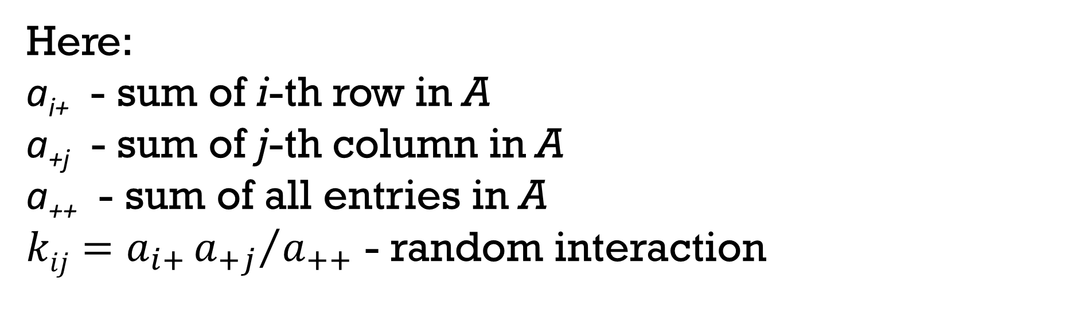
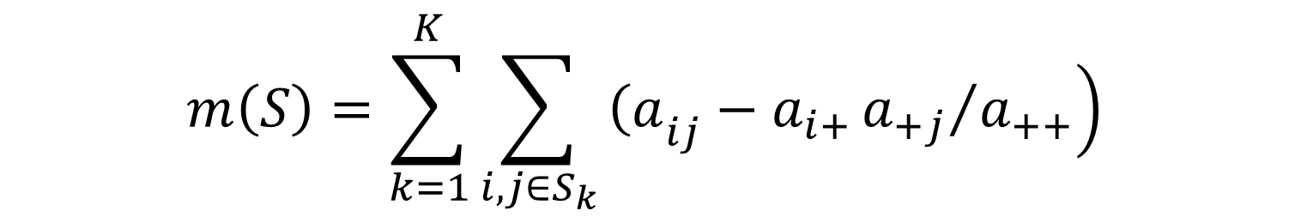
Summary clustering with modularity transformation (much popular), 1
$$m\left(S\right)=\sum_{k=1}^{K}{\sum_{i,j∈S_{k}}{\left.{\left(a\right.}_{ij}−a_{i+}{a_{+j}}/{a_{++}}\right)}}$$
Here:
a_{i+} - sum of i-th row in A
a_{+j} - sum of j-th column in A
a₊₊ - sum of all entries in A
${kij=a}_{i+}{a_{+j}}/{a_{++}}$ - random interaction

Slide 27
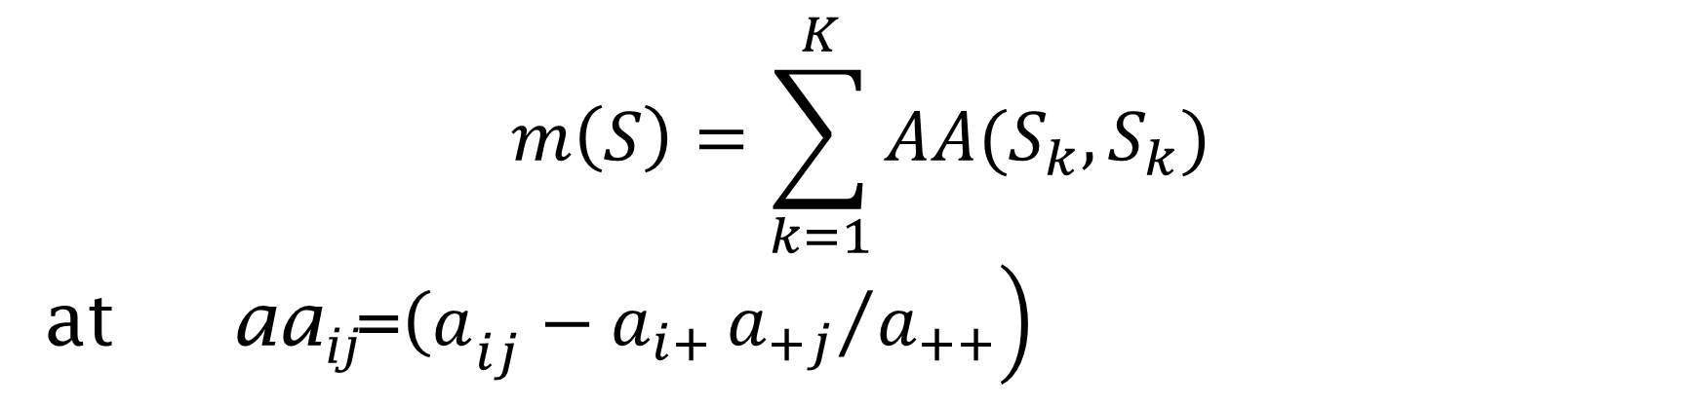
Summary clustering with modularity approach (much popular), 2
$$m\left(S\right)=\sum_{k=1}^{K}{AA(S_{k},S_{k}) }$$
at aa_{ij}=$\left.{\left(a\right.}_{ij}−a_{i+}{a_{+j}}/{a_{++}}\right)$
In my experiments:
Modularity is good at clustering for weighted networks,
Uniform shift is good at clustering for flat networks

Slide 28
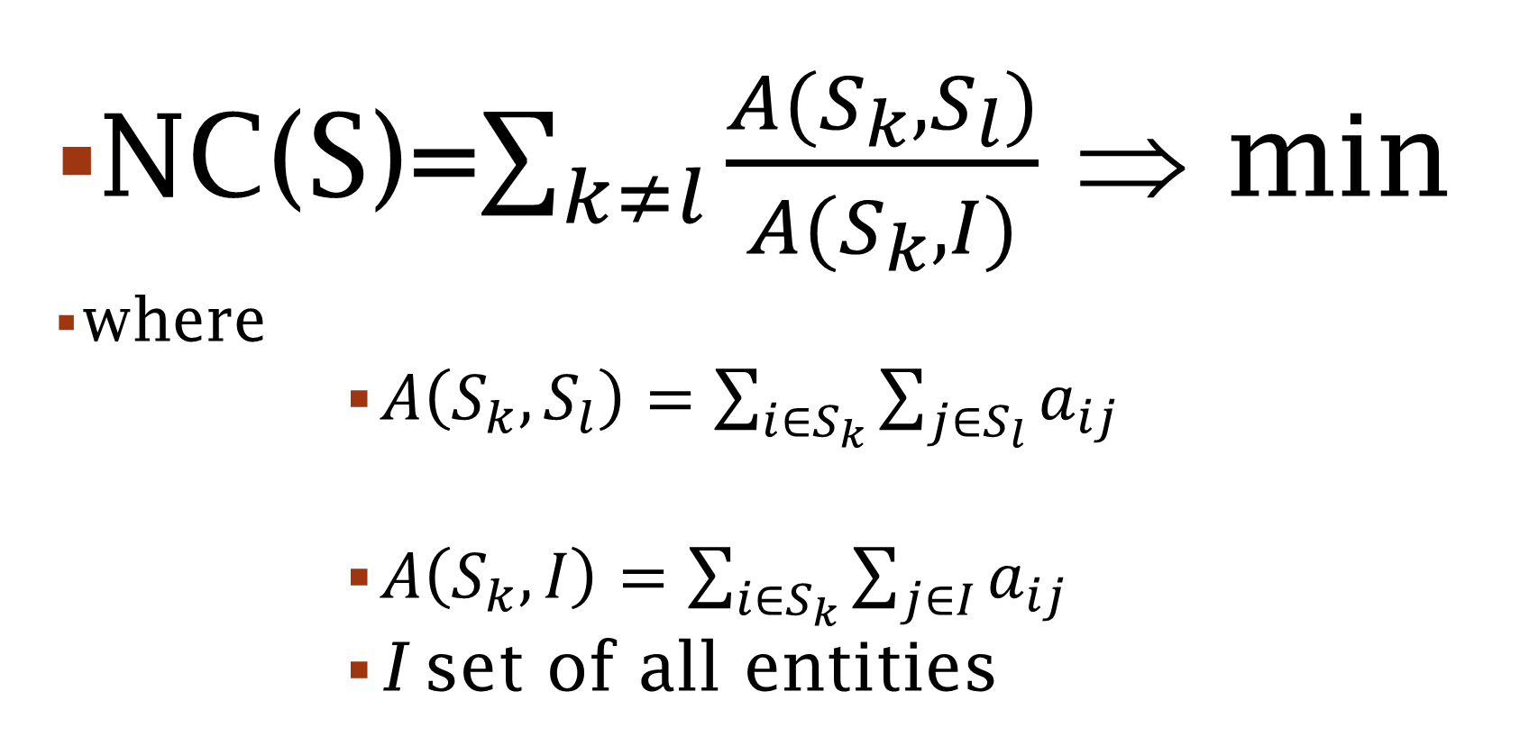
Normalized cut and spectral clustering,1
                NC(S)=$\sum_{k≠l}{\frac{A(S_{k},S_{l})}{A(S_{k}, I)}}$ ⇒ min
where
              $A\left(S_{k},S_{l}\right)=\sum_{i∈S_{k}}{\sum_{j∈S_{l}}{a_{ij}}}$
              $A\left(S_{k},I\right)=\sum_{i∈S_{k}}{\sum_{j∈I}{a_{ij}}}$
              I set of all entities

Slide 29
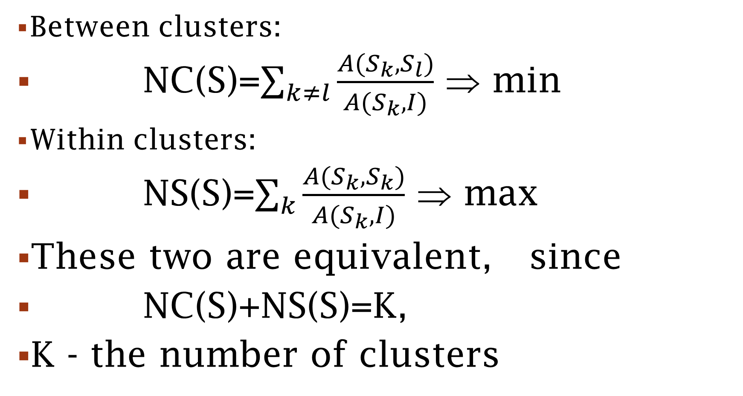
Normalized cut and spectral clustering,2
Between clusters:
                NC(S)=$\sum_{k≠l}{\frac{A(S_{k},S_{l})}{A(S_{k}, I)}}$ ⇒ min
Within clusters:
                NS(S)=$\sum_{k}{\frac{A(S_{k},S_{k})}{A(S_{k}, I)}}$ ⇒ max
                These two are equivalent, since
                NC(S)+NS(S)=K,
                K - the number of clusters

Slide 30
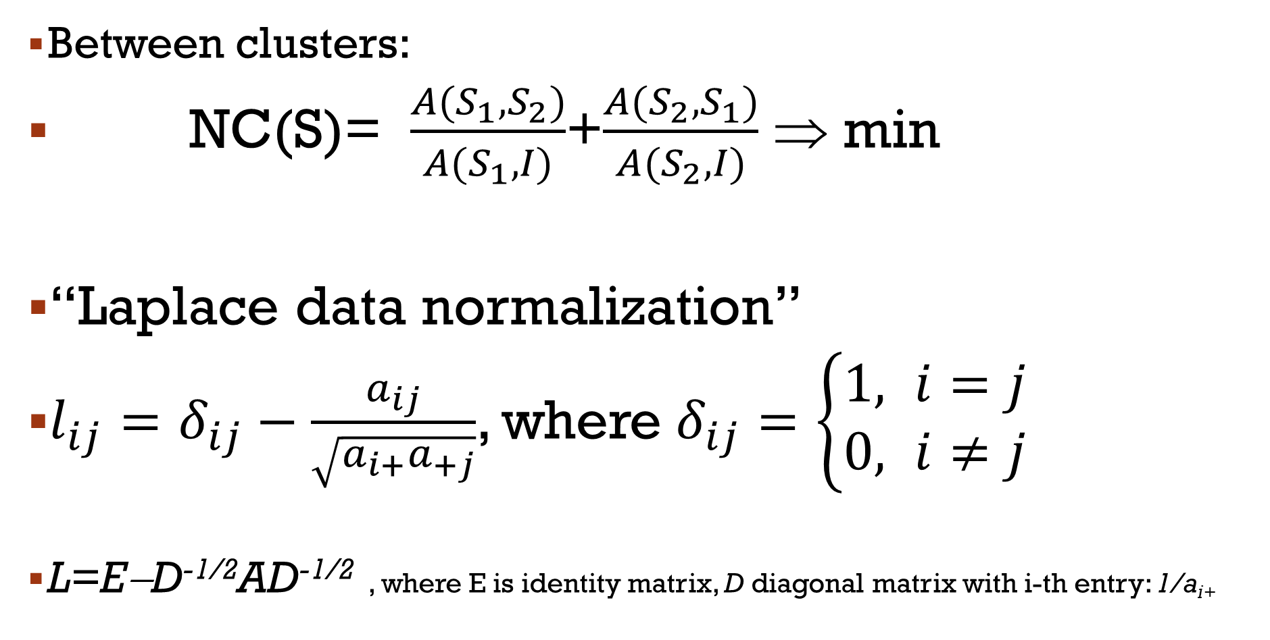
Normalized cut and spectral clustering,3: Case K=2
Between clusters:
                NC(S)= $\frac{A(S_{1},S_{2})}{A(S_{1}, I)}$+$\frac{A(S_{2},S_{1})}{A(S_{2}, I)}$ ⇒ min
                “Laplace data normalization”
                $l_{ij}=δ_{ij}−\frac{a_{ij}}{\sqrt{a_{i+}a_{+j}}}$, where $δ_{ij}=\left\{\begin{aligned}1, i=j \\ 0, i≠j\end{aligned}\right.$
L=E−D^{-1/2}AD^{-1/2} , where E is identity matrix, D diagonal matrix with i-th entry: 1/a_{i+}

Slide 31
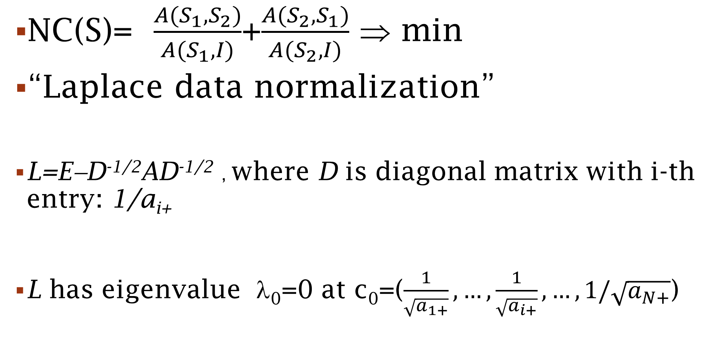
Normalized cut and spectral clustering,4: Case K=2
NC(S)= $\frac{A(S_{1},S_{2})}{A(S_{1}, I)}$+$\frac{A(S_{2},S_{1})}{A(S_{2}, I)}$ ⇒ min
                “Laplace data normalization”
L=E−D^{-1/2}AD^{-1/2} , where D is diagonal matrix with i-th entry: 1/a_{i+}
L has eigenvalue λ₀=0 at c₀=($\frac{1}{\sqrt{a_{1+}}}, …,\frac{1}{\sqrt{a_{i+}}}, …,1/\sqrt{a_{N+}}$)

Slide 32
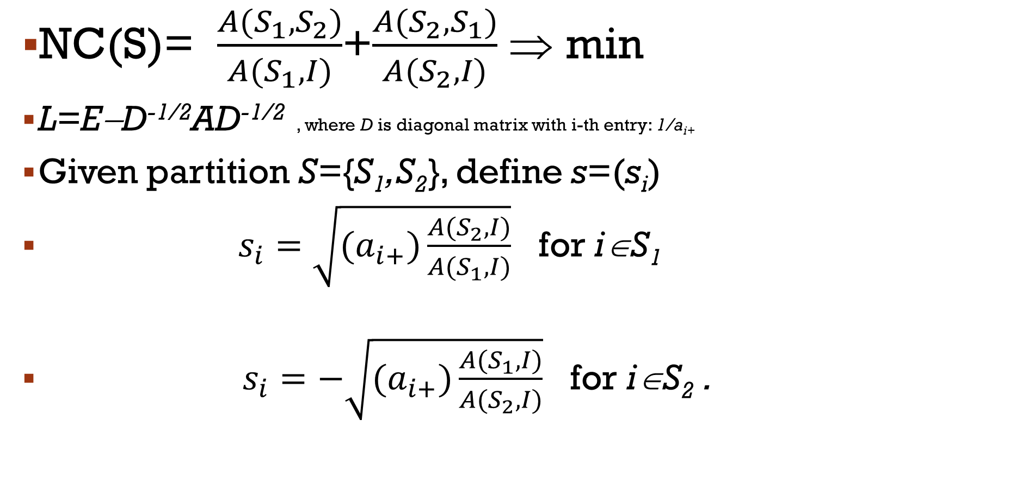
Normalized cut and spectral clustering,5: Case K=2
NC(S)= $\frac{A(S_{1},S_{2})}{A(S_{1}, I)}$+$\frac{A(S_{2},S_{1})}{A(S_{2}, I)}$ ⇒ min
                L=E−D^{-1/2}AD^{-1/2} , where D is diagonal matrix with i-th entry: 1/a_{i+}
Given partition S={S₁,S₂}, define s=(s_{i})
$s_{i}=\sqrt{(a_{i+})\frac{A(S_{2},I)}{A(S_{1},I)}}$ for i∈S₁
$s_{i}=−\sqrt{(a_{i+})\frac{A(S_{1},I)}{A(S_{2},I)}}$ for i∈S₂ .

Slide 33
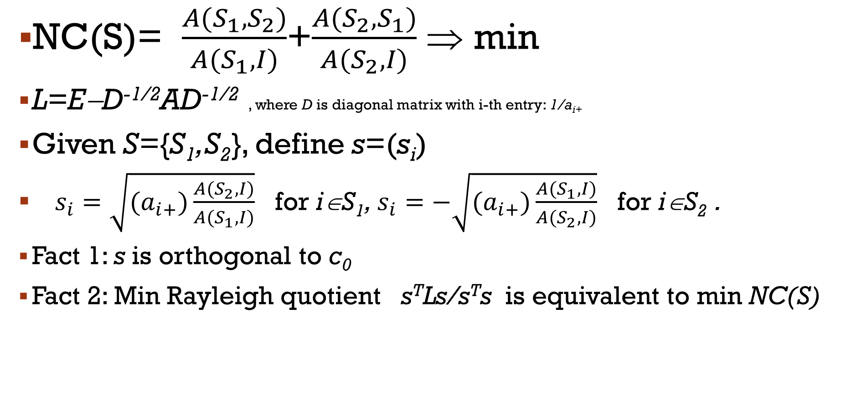
Normalized cut and spectral clustering,6: Case K=2
NC(S)= $\frac{A(S_{1},S_{2})}{A(S_{1}, I)}$+$\frac{A(S_{2},S_{1})}{A(S_{2}, I)}$ ⇒ min
                L=E−D^{-1/2}AD^{-1/2} , where D is diagonal matrix with i-th entry: 1/a_{i+}
Given S={S₁,S₂}, define s=(s_{i})
$s_{i}=\sqrt{(a_{i+})\frac{A(S_{2},I)}{A(S_{1},I)}}$ for i∈S₁, $s_{i}=−\sqrt{(a_{i+})\frac{A(S_{1},I)}{A(S_{2},I)}}$ for i∈S₂ .
Fact 1: s is orthogonal to c₀
Fact 2: Min Rayleigh quotient s^{T}Ls/s^{T}s is equivalent to min NC(S)

Slide 34
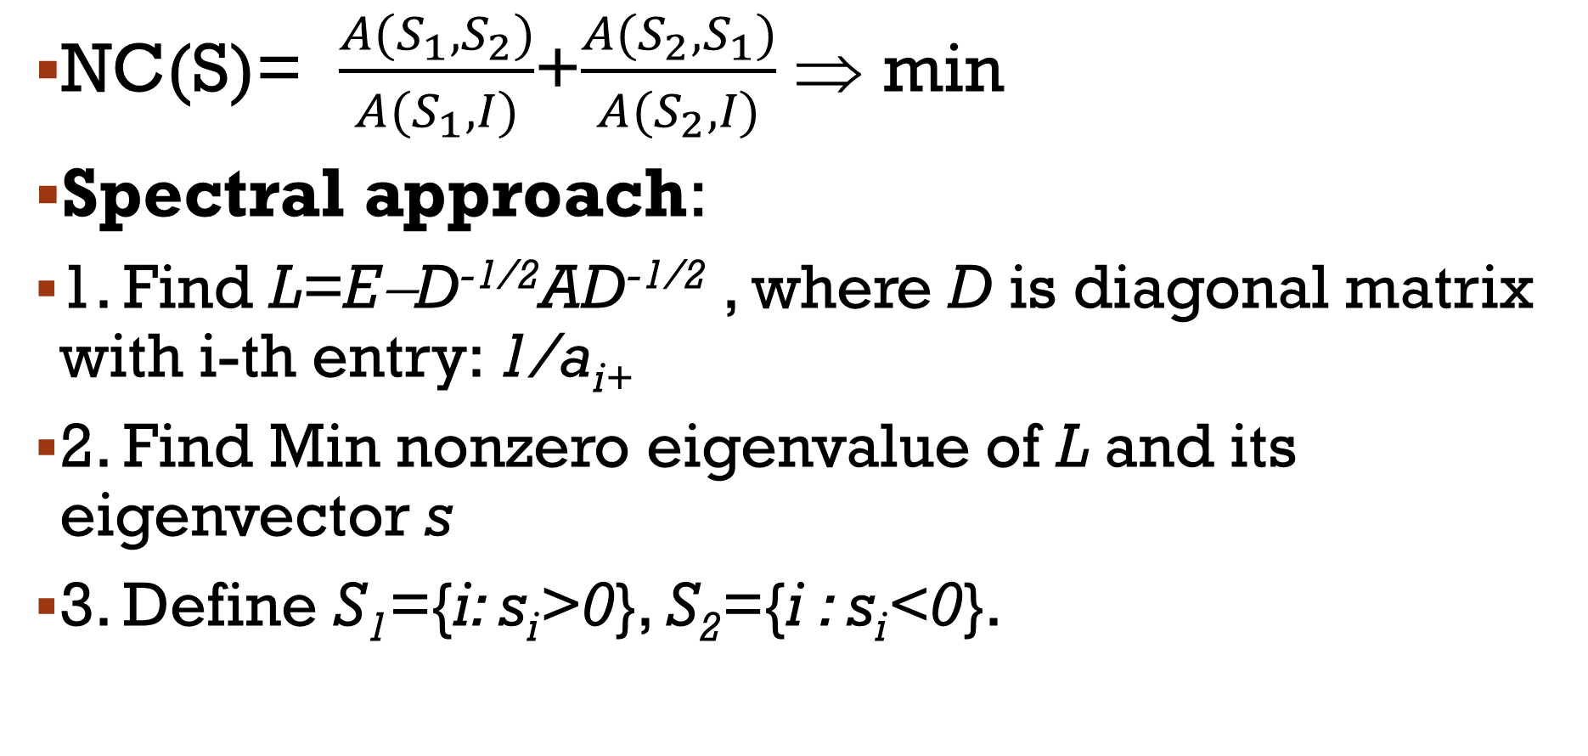
Normalized cut and spectral clustering,7: Case K=2
NC(S)= $\frac{A(S_{1},S_{2})}{A(S_{1}, I)}$+$\frac{A(S_{2},S_{1})}{A(S_{2}, I)}$ ⇒ min
Spectral approach:
                1. Find L=E−D^{-1/2}AD^{-1/2} , where D is diagonal matrix with i-th entry: 1/a_{i+}
2. Find Min nonzero eigenvalue of L and its eigenvector s
3. Define S₁={i: s_{i}>0}, S₂={i : s_{i}<0}.

Slide 35
Lecture contents
Similarity data types
Similarity clusters inherited from k-means: Semi-average clustering criterion
  One-cluster clustering
  Agglomeration; stopping criterion
Summary criteria
  Uniform threshold
  Modularity transformation
Normalized cut, Laplace transformation, and spectral clustering

